Slide 1
Software Architecture of Intel 8088/8086 Processor
Dr.N.Arulanand, Professor,
PSG College of Technology

Slide 2
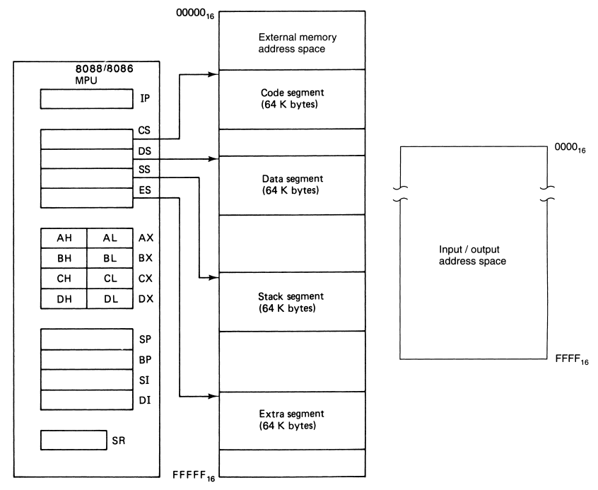
Software Model of the 8088/8086 microprocessor
NOTE:
1 MB of External Memory
I/O Address Space – 64KB
No of 16-bit Registers: 13
IP
CS, DS, ES,SS
AX,BX,CX,DX
SP,BP,SI,DI
In addition:
SR – Status Register or Flag Register

Slide 3
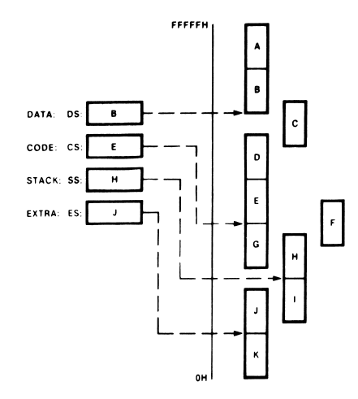

Memory Segment
Only four of these 64Kbyte segments are active at a time:
Code is always fetched from memory as words, not as bytes

Slide 4
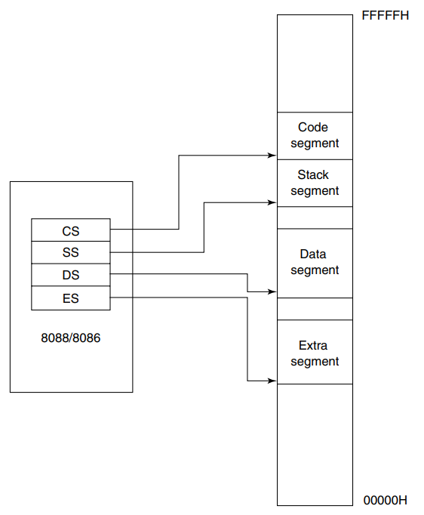
Active Segments of the Memory
The Segment registers are user accessible
Programmer can change the contents through software
For Example: new data space upto 128 kbytes is brought simply by changing the values in DS and ES register
Restriction: The address must reside on a 16-byte boundary. Valid addresses are 00000H,00010H,00020H
Segments can be continuous, adjacent, disjointed or even overlapping

Slide 5
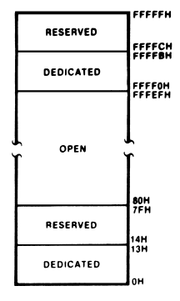

Dedicated and Reserved Address Spaces
00H to 7FH (128 bytes) of memory are used to store the pointers to interrupt service routines.
The dedicated part is used to store the pointers for the 8088’s internal interrupts and exceptions.
The reserved locations are used by the user-defined interrupts

Slide 6
Instruction Pointer (IP)
IP identifies the location of the next word to be fetched
Looks similar to Program Counter. However, contains the offset address instead of its actual address
CS is 16-bit in length, IP is 16-bit in length
Value of next code address is CS:IP
IP is incremented by 2 bytes

Slide 7
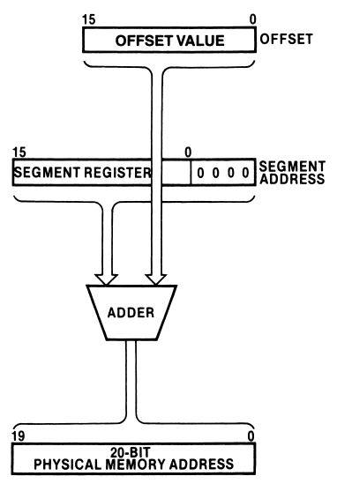
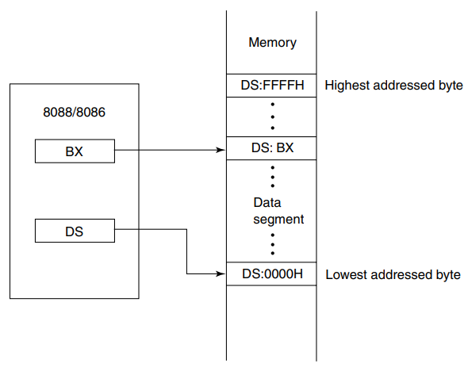
Generating a Memory Address
The generation of the physical address involves combining a 16-bit offset value that is located in the instruction pointer, a base register, an index register, or a pointer register and a 16-bit segment base value that is located in one of the segment registers.
CS:IP
DS:DI
SS:SP
Segment Base Register – represent the starting location of the 64K byte segment .i.e., the lowest byte in the segment

Slide 8
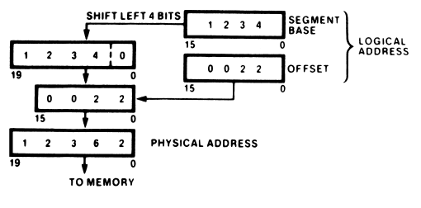
Physical Address Calculation

Slide 9
Question
What would be the offset address required to map to physical location 002C3H, if the contents of the corresponding segment register is 002AH ?

Slide 10
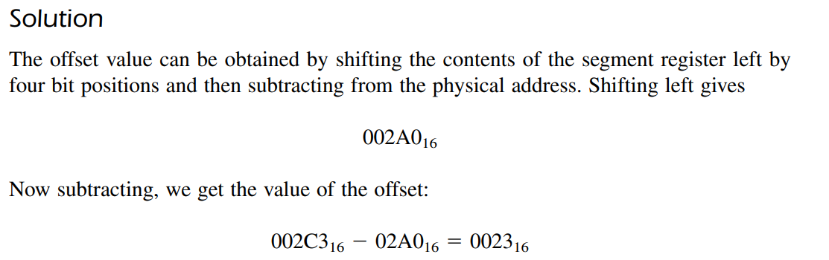

Slide 11
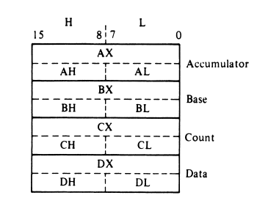
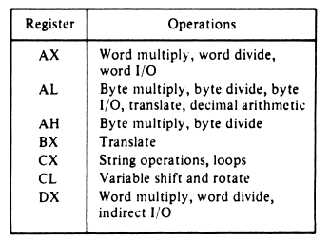
Data Registers
The accumulator register (A), the base register (B), the count register (C), and the data register (D)
These names imply special functions they are meant to perform for the microprocessor. Notice that string and loop operations use the C register.
For example, the value in the C register is the number of bytes to be processed in a string operation. This is the reason it is given the name count register.
Another example of the dedicated use of data registers is that all input/output operations must use accumulator AL or AX for data
For the A register, the most significant byte is referred to as AH and the least significant byte as AL

Slide 12
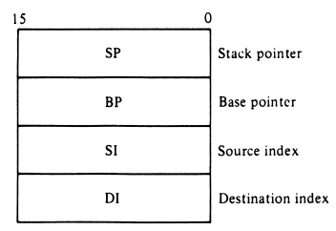
Pointer and Index Register
The values in SP and BP are used as offsets from the current value of SS during the execution of instructions that involve the stack segment of memory
combining SP with the value in SS (SS:SP) results in an address that points to the top of the stack (TOS)
BP also represents an offset relative to the SS; however, it is used to access data within the stack segment of memory.
One common use of BP is to reference parameters that are passed to a subroutine by way of the stack.
Source index (SI) register holds an offset address that identifies the location of a source operand
Destination Index (DI) register holds location of destination operand
DS or ES register are used along with the Index Register

Slide 13
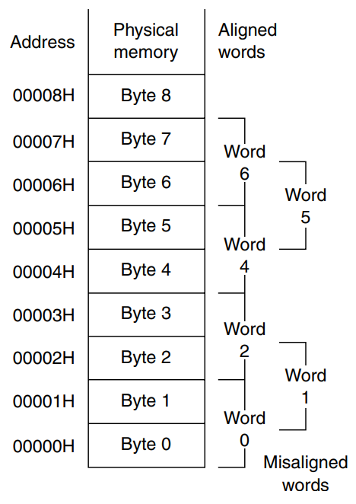
Aligned and Mis-aligned Words
A word of data stored at an even-address boundary, such as 00000₁₆, 00002_{16,} etc are said to be ALIGNED WORDS
A word of data stored at an odd address boundary, such as 00001₁₆, 00003₁₆, or 00005₁₆ and so on, is called a misaligned words

Slide 14
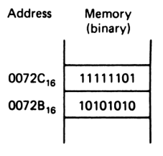
Question
What is the data word shown in fig ?
Express the result in hexadecimal form.
Is it stored at an even- or odd-addressed word boundary?
Is it an aligned or misaligned word of data?

Slide 15
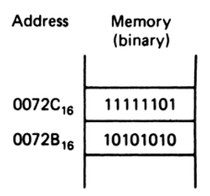
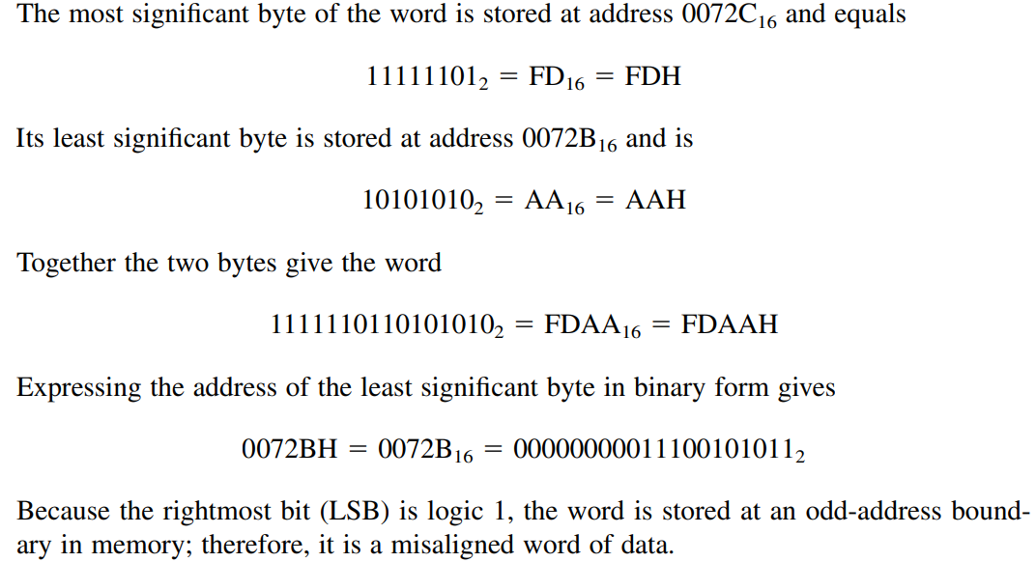
Solution
Little Endian:
Lower order Byte is stored first and then higher order byte.

Slide 16
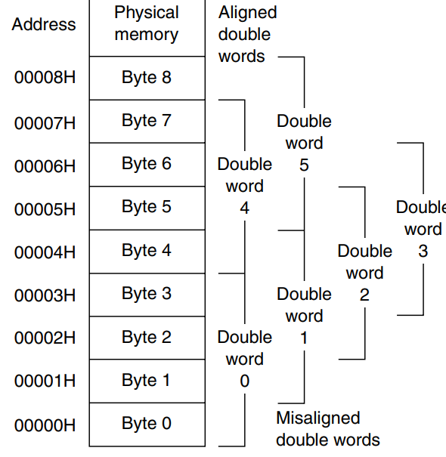
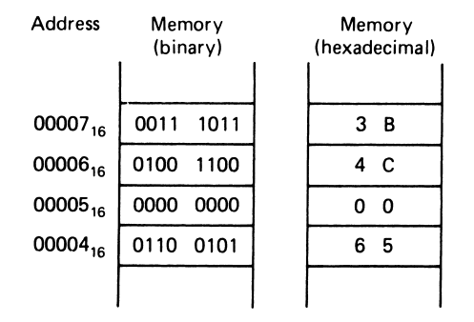
Aligned and Mis-aligned Double words

Slide 17
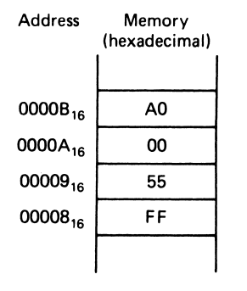
Question: Express the double word ?

Slide 18
Signed Integer word: Question
A signed word integer equals FEFF₁₆ . What decimal number does it represent?

Slide 19
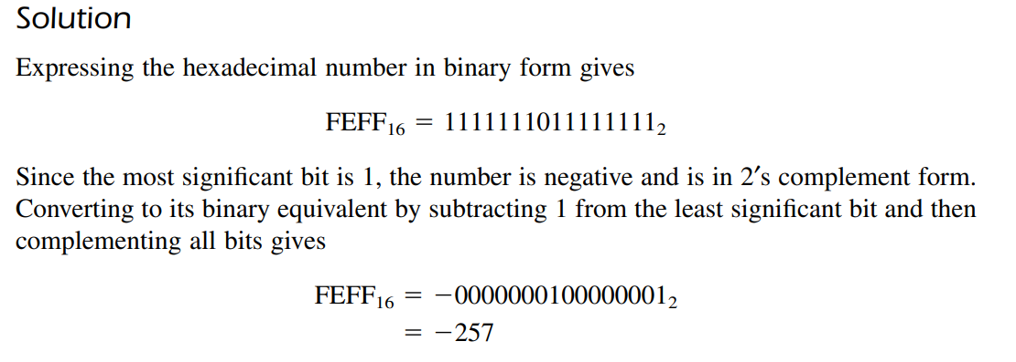

Slide 20
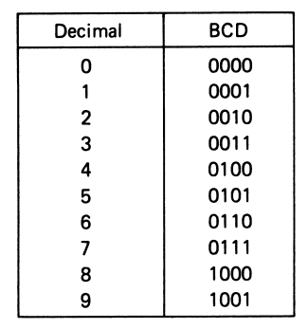
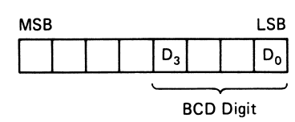
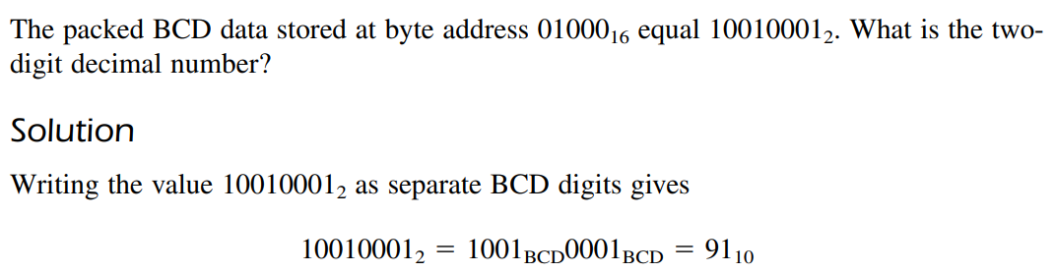
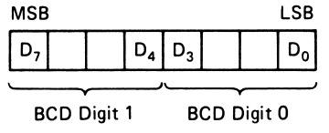
BCD Numbers – Packed BCD and Unpacked BCD
An unpacked BCD byte shows that a single BCD digit is stored in the four least significant bits, and the upper four bits are set to 0

Slide 21
Thank You

